Slide 1

Technology Operations
Internal Hardware
Session 2
Tutor: Tshewang Dhendup

Slide 2
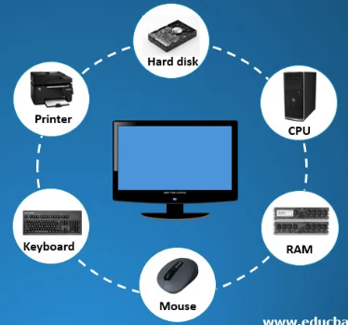

Internal Hardware
Learning Objectives:
At the end of the lesson, you should be able to:
identify internal hardware components.
explain the functions of different internal hardware components.
Notes:
in today’s lesson will cover internal hardware and its functions.

Slide 3
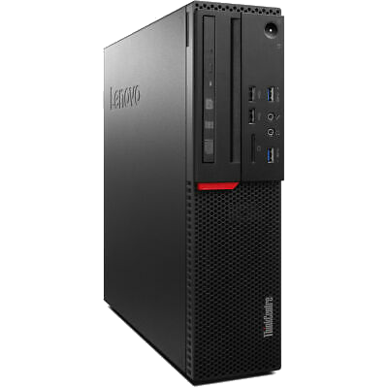
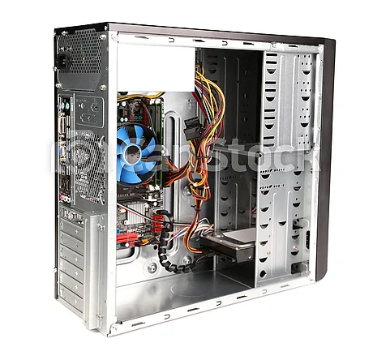
Internal Hardware

Slide 4
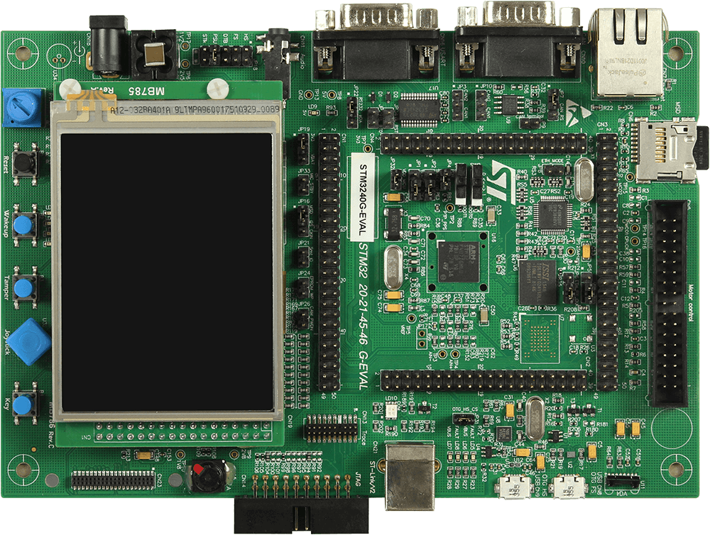
Internal Hardware
1. Motherboard
The motherboard is the main circuit board in a computer.
It is responsible for connecting all the internal hardware components together.
It contains the CPU, memory, and other important components.

Slide 5
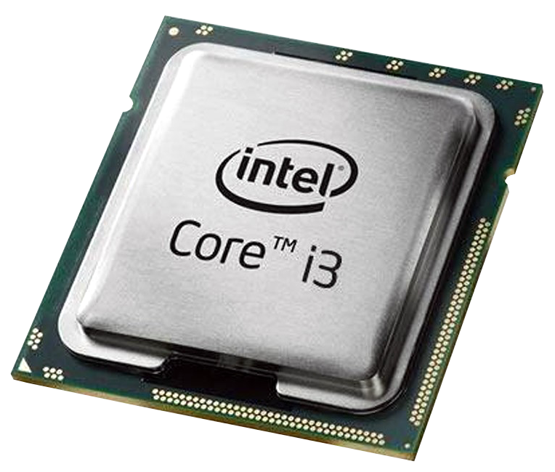
Internal Hardware
2. Processor or CPU (Central Processing Unit)
CPU is the brain of the computer.
It executes instructions and performs calculations for the computer.

Slide 6
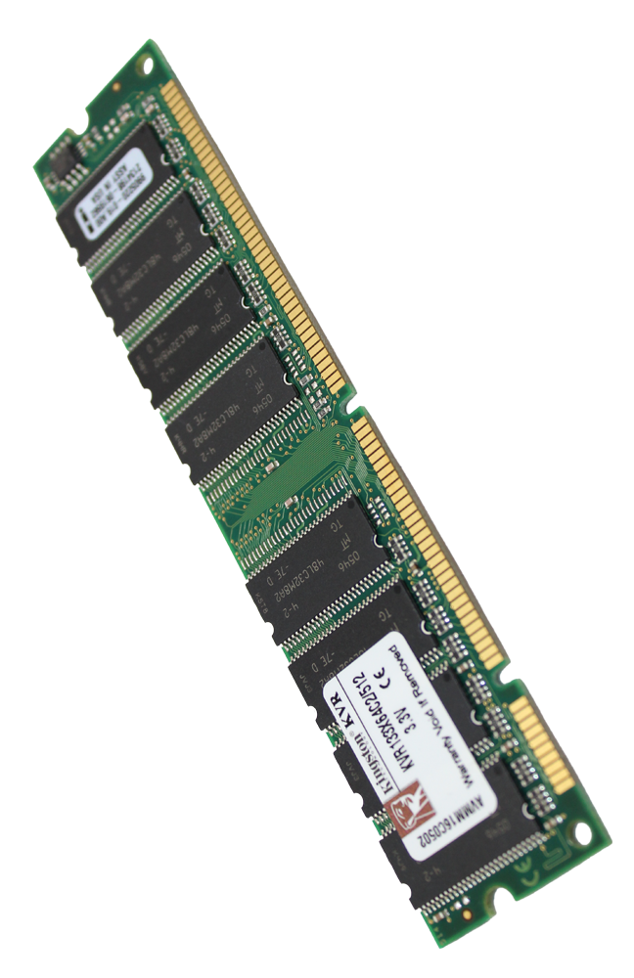
Internal Hardware
3. RAM (Random Access Memory)
RAM is used to store data temporarily while the computer is running.
It allows the computer to access data quickly.
It is located on the motherboard.

Slide 7
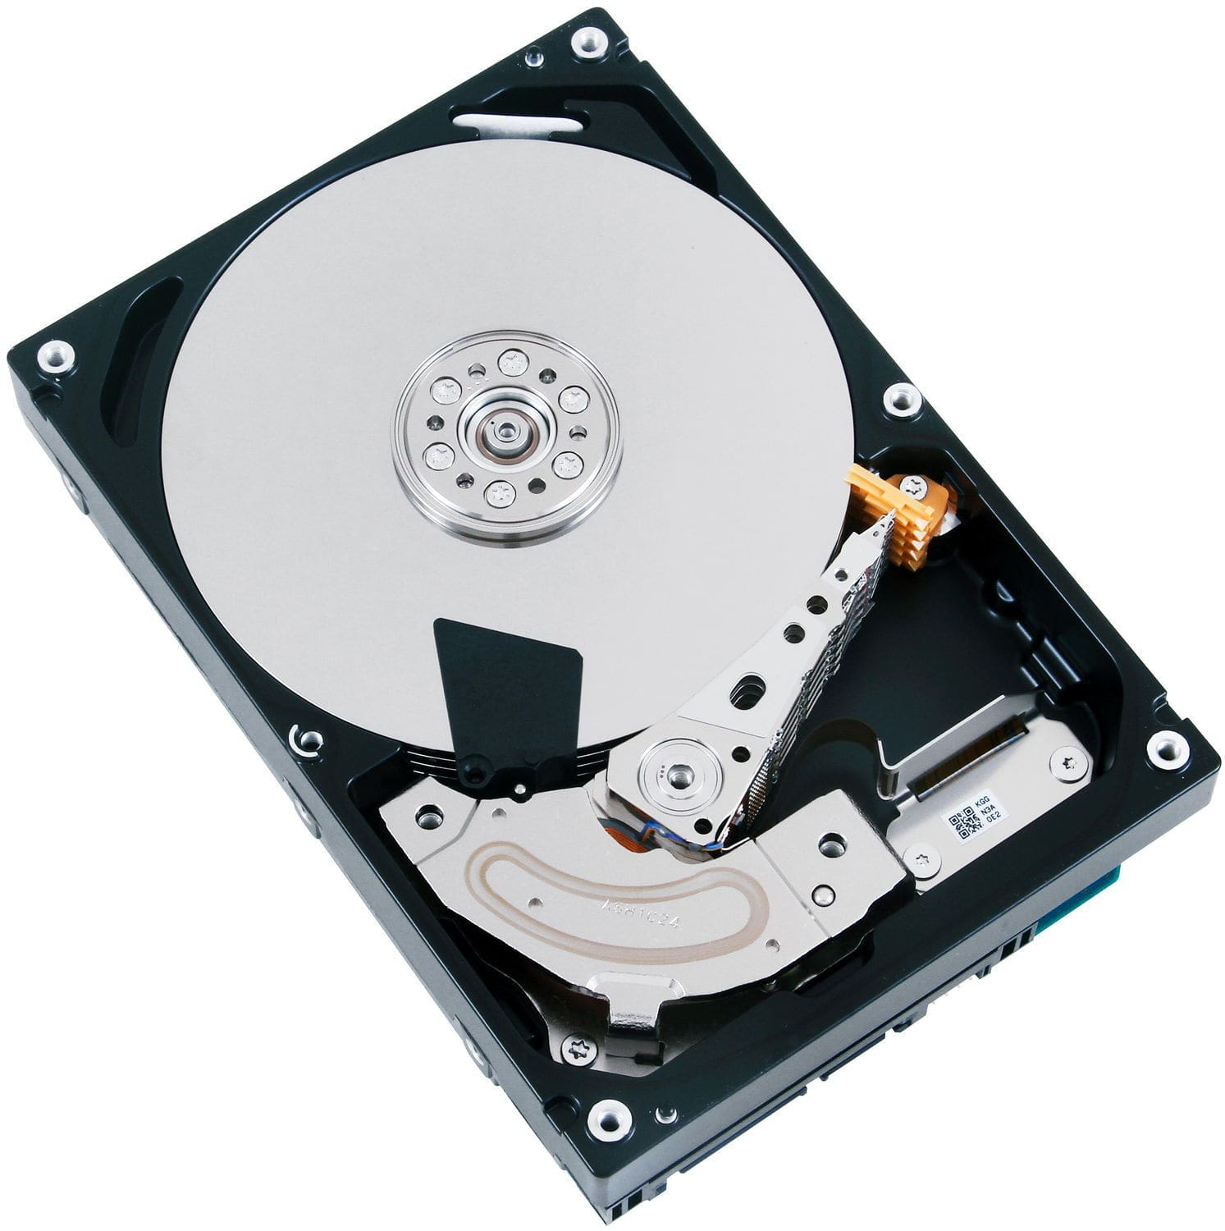
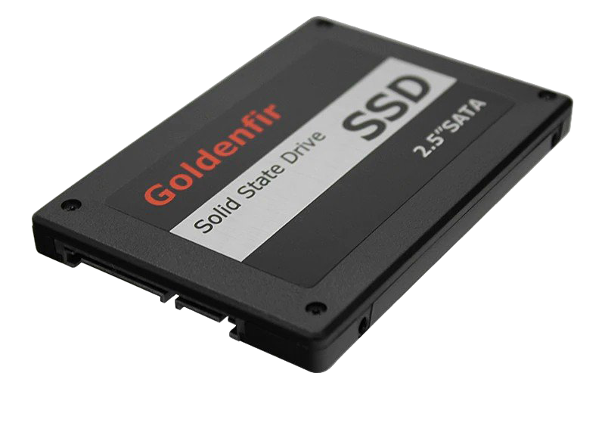
Internal Hardware
4. Storage devices
Storage devices are used to store data permanently.
They include hard disk drives (HDD) and solid state drives (SSD).

Slide 8
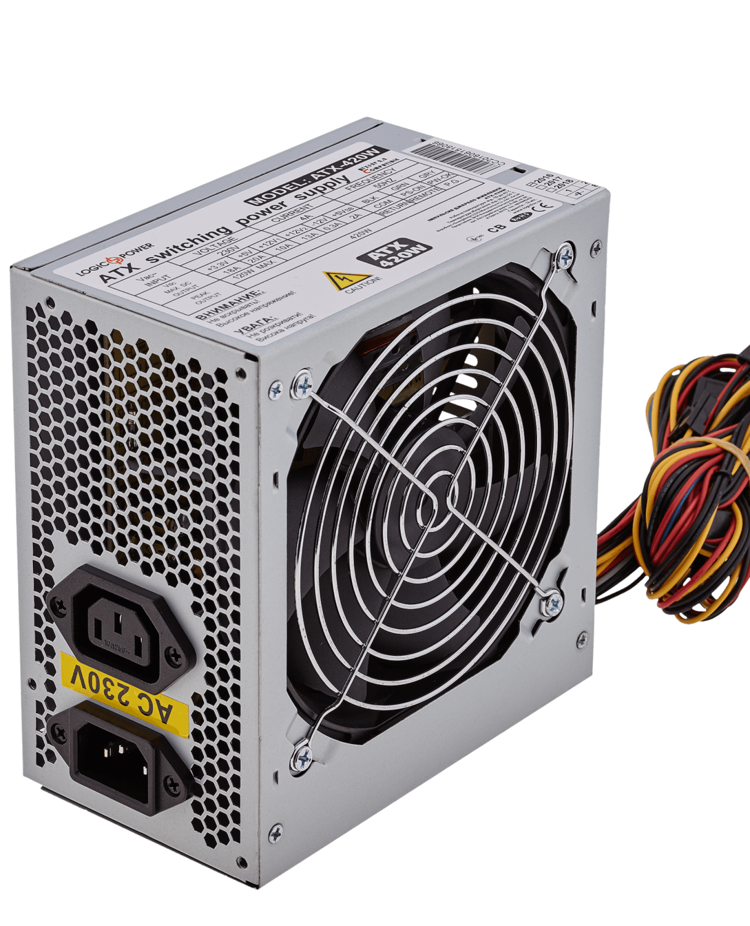
Internal Hardware
5. Power Supply Unit
It is responsible for providing power to all the internal hardware components.

Slide 9
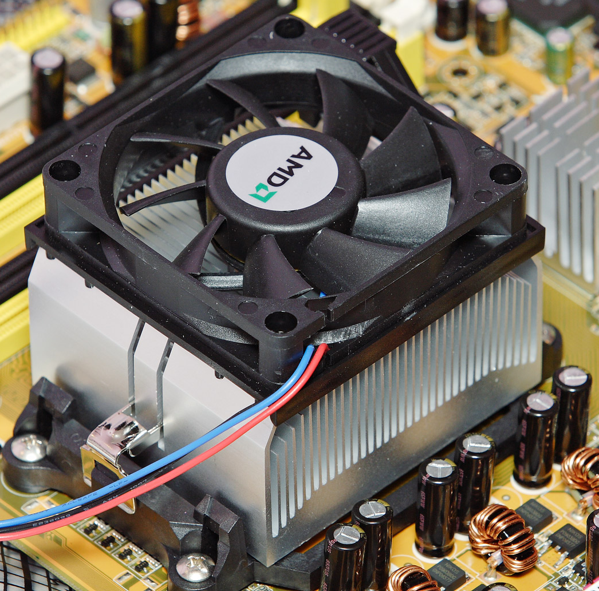
Internal Hardware
6. System cooling fan
It helps to keep the internal components cool by circulating air through the system unit.

Slide 10
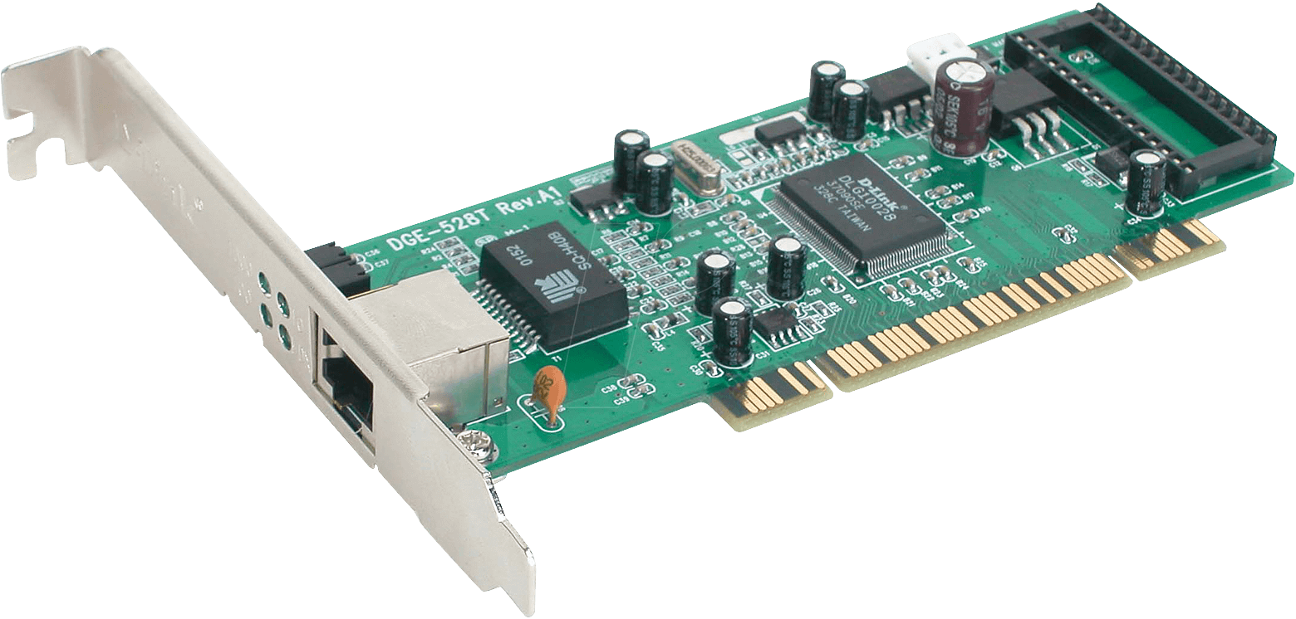
Internal Hardware
7. Network Interface Card
It is responsible for connecting the computer to a network (such as the internet).

Slide 11


